Slide 1

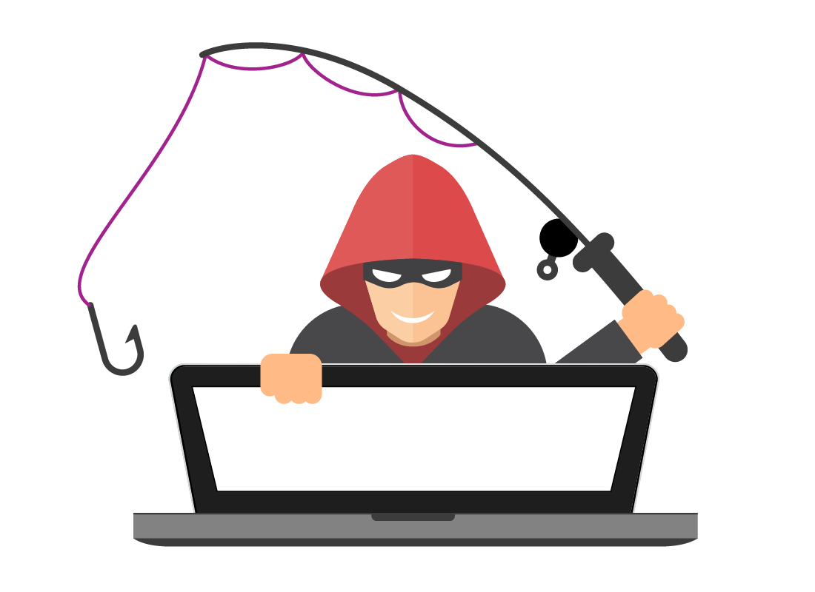

Phishing Awareness Training
Protecting Yourself & Your Organization

Slide 2
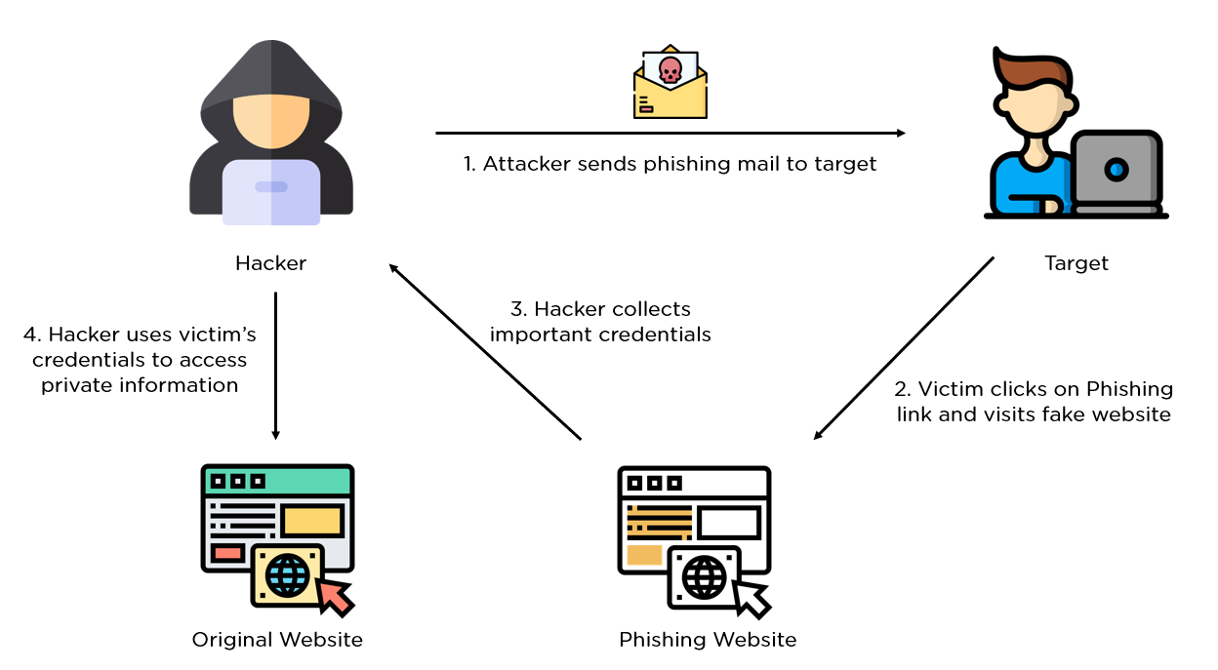
What is Phishing? (Introduction)
Phishing = most common cyber threat .
90% of attacks start with phishing emails/messages .
Uses deception & social engineering .
Goal: steal info or install malware .

Slide 3
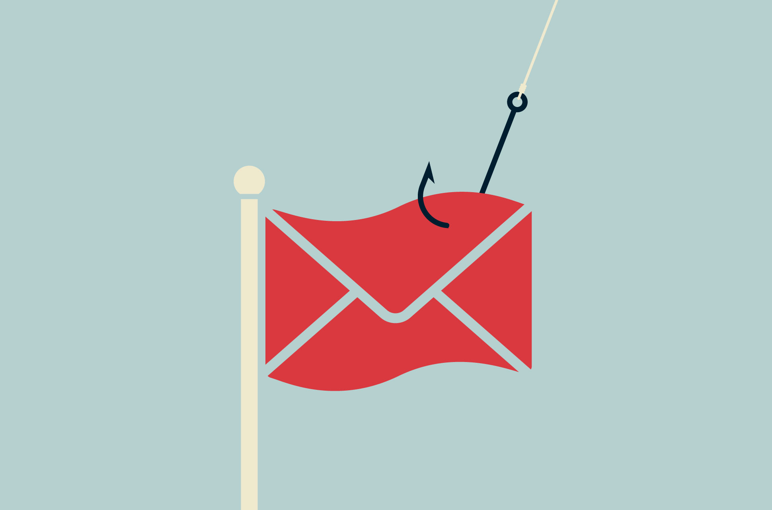
Recognizing Phishing Emails
Signs of phishing:
Suspicious/similar domains (micros0ft-teams.net) .
Urgent or threatening language .
Poor spelling & grammar .
Requests for sensitive info .
Suspicious links or attachments .

Slide 4
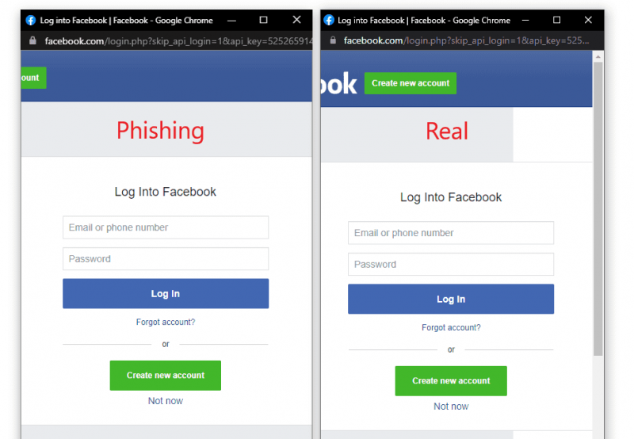
Spotting Fake Websites
Always check:
“https://” + padlock 🔒 (but not 100% safe) .
Misspelled domains (yah00 vs yahoo) .
Hover over links before clicking .

Slide 5


Social Engineering Tactics
Attack methods:
Phishing, spear phishing .
Vishing (phone), Smishing (SMS) .
Baiting, Pretexting, Quid pro quo .
Example: Fake IT support calls (sometimes with AI voice cloning) .

Slide 6
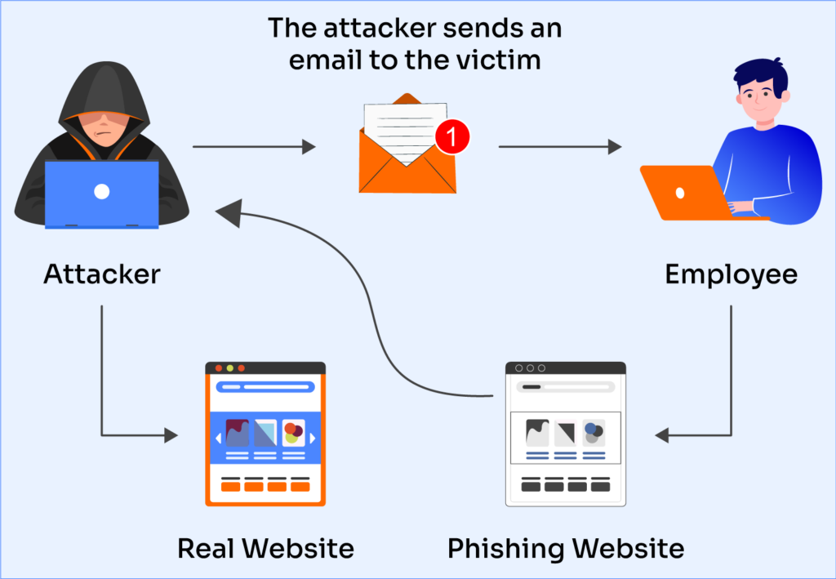
Psychology Behind Attacks
Attackers exploit:
Trust
Urgency
Curiosity
Fear (Visual: diagram showing emotions → phishing tactics)

Slide 7

Best Practices to Stay Safe
Verify sender’s full email/domain .
Don’t click suspicious links/attachments .
Confirm requests using official contacts .
Use MFA & strong passwords .
Report suspicious emails immediately .
Join regular phishing awareness training .

Slide 8

Real-World Phishing Examples
Google & Facebook lost $100M (fake invoices)
Colonial Pipeline ransomware → phishing email
Healthcare & government targeted for data theft

Slide 9
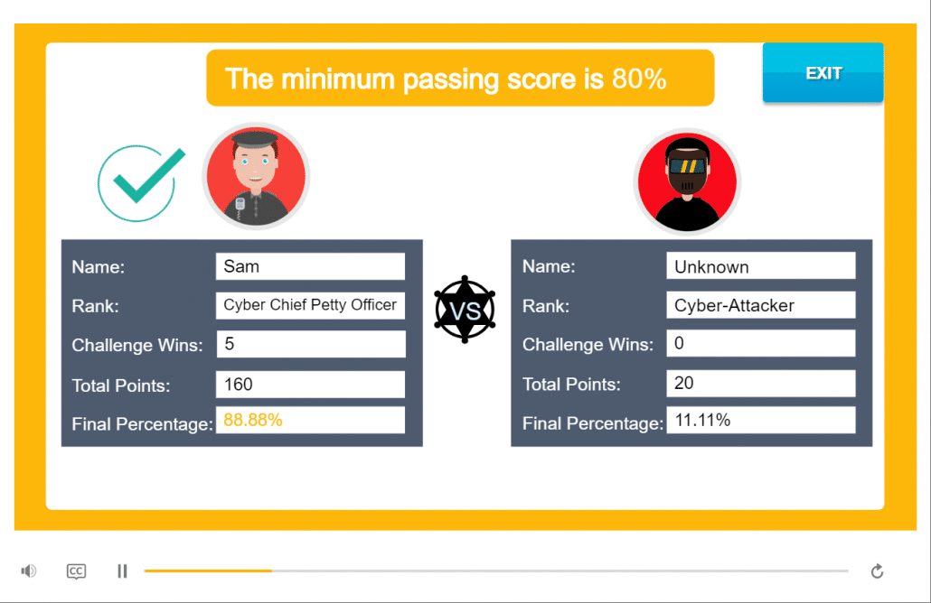
Training & Simulations
Gamified phishing training:
Guardey (weekly phishing challenges)
ProProfs (user-generated quizzes)
Infosequre (AI phishing games)
Realistic simulations boost resilience

Slide 10

Conclusion
Phishing = most common cyber risk
Awareness + practice = strongest defense
Stay alert, verify before you click, report quickly

